Slide 1


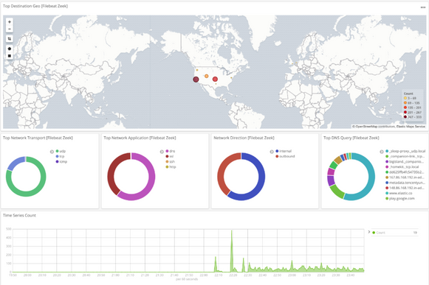
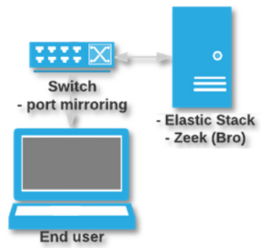

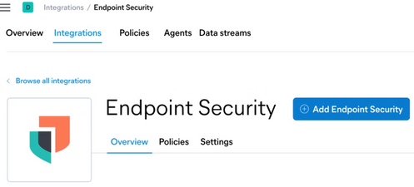
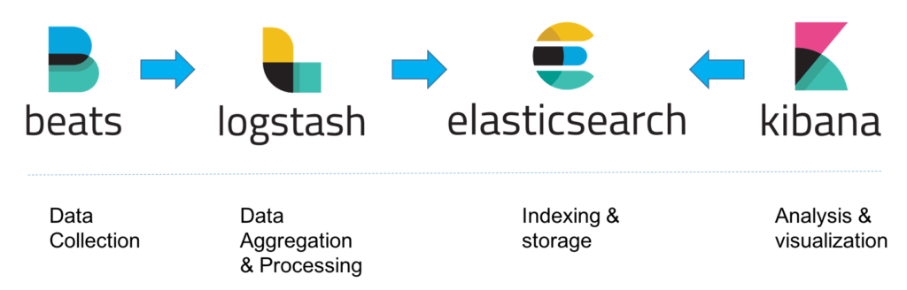

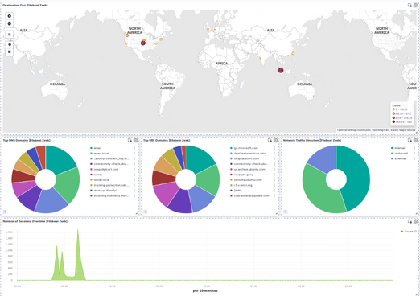

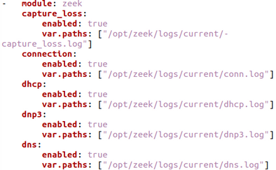
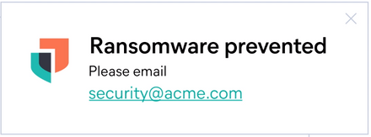

ZEEK & ELASTIC STACK
AUTHORS
Tan Jia Shun, Alan
Zeek
Zeek also known as Bro is an open-source software for analyzing network traffic. Zeek provides capabilities that are similar to a network intrusion detection systems (IDS) where it can log the network traffic but other than just being an IDS, it also provide feature that is useful for forensics investigation.
Key Feature
COMPREHENSIVE NETWORK LOG
FILE EXTRACTION
SCRIPTING
Zeek will turn raw network traffic into a comprehensive logs that is organized by protocol and the traffic data is filter and storage in different field
Zeek can extract and reassemble file from the network. This allow the system to sent the file to an analysis tool to analyze or be stored on a backup server which could be used for investigation later
You are able to create your own script which could be used to automate traffic analysis task to your liking. Or you can also download pre-made script make the others.
Elastic Stack
Elastic Stack is a web application that help user to take, store and format the data so that it is easier to search, analyze and visualize the data in real time. It also allow integration to many in-house and third-party security tool, making the application very powerful for network analysis.
Key Feature
DATA VISUALIZATION
ADVANCE THREAT DETECT
ENDPOINT SECURE
It make huge and complex data easier and quicker to read and understand by using graphic, map and vector
It have a prebuilt machine learning system which study the network traffic and prepare for any threat unique to the network environment by providing alert and action rule that the user may not have set.
Elastic stack have an endpoint agent application that can be installed to device to prevent a malicious attack
Setup
Step 5 (ElasticSearch configuration)
Step 1 (Network)
Set license to trial and enable security in /etc/elasticsearch/elasticsearch.yml to enable security feature
In terminal, run "systemctl restart elasticsearch.service" to restart ElasticSearch
Setup a Linux base server and connect it to a switch where the port is configured to mirroring so that switch will send a copy of the network packet to the server
Step 6 (Enable Endpoint Security)
In ElasticSearch webpage, from the menu, go to integration
Look for Endpoint Security and click add
Step 2 (Installation)
Install Zeek, Filebeats, ElasticSearch and Kibana to the server
Install Elastic Endpoint on the client device
Results
Step 3 (Zeek configuration)
The Filebeat Zeek dashboard in ElasticSearch webpage should display information about you network (exp. Top URL Domain)
Set the interface that is connected to the switch in /opt/zeek/ect/node.cfg
In terminal, run "zeekctl deploy" to start zeek
Step 4 (Filebeat configuration)
In terminal, run "filebeat modules enable zeek" to enable Zeek for Filebeat
Set the path of Zeek log in /etc/filebeat/modules.d/zeek.yml
In terminal, run "systemctl restart filebeat" to restart Filebeat
When you run a Ransomware file on the client, elastic endpoint should prevent it
When you run a Ransomware file on the client, elastic endpoint should prevent it

